Slide 1

MAVEN
UE Advanced Web Development
Mariam Nourya Koné

Slide 2

What is MAVEN ?
”Maven” is a Yiddish(jewish) word which means “accumulator of knowledge”
Software management and comprehension tool
Project Oriented Model (POM)
Manages project’s build, reporting and documentation

Slide 3
MAVEN’s Objectives
Making the build process easy
Providing a uniform build system
Providing quality project information
Providing guidelines for best practices development
Allowing transparent migration to new features

Slide 4
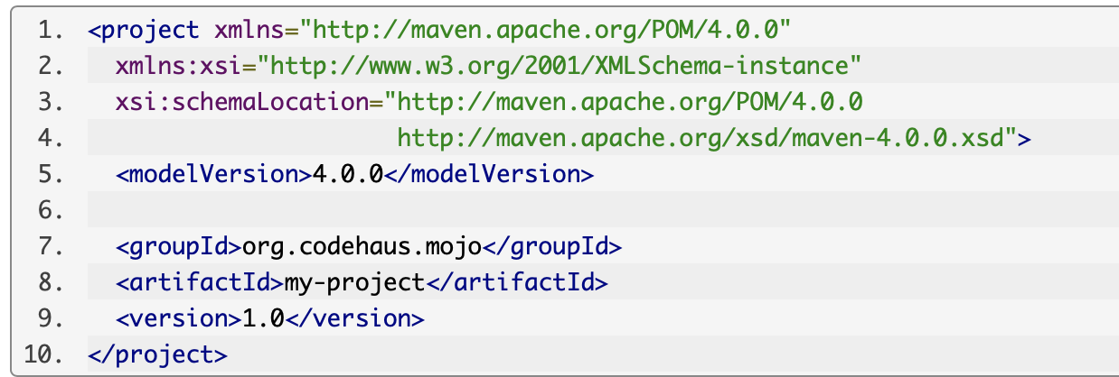
POM (Project Object Model) file example

Slide 5
What is MAVEN NOT ?
Maven is a site and documentation tool
Maven extends Ant to let you download dependencies
Maven is a set of reusable Ant scriptlets

